Slide 1
Lesson 09 Remainder/Factor Theorem and Partial Fraction Decomposition
Interactive Seminar Slides
E114 – Mathematics for Engineering

Slide 2
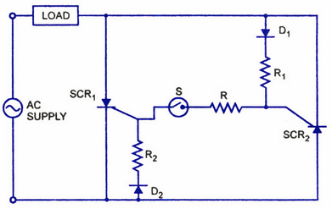
Scenario
An electrical engineer is working on a particular electric circuit design that works on an alternating voltage supply.
When testing out his circuit, he finds that the electric voltage, V (in volts) in his circuit varies with time t (in minutes) according to the expression
Source: Google Image
http://www.circuitstoday.com/scr-applications
He also noticed that when t=1, V=0 and is curious to find out what are the other times when V=0.
Furthermore, he finds that the electric current, i(in amperes) also varies with t and is given by the expression

Slide 3
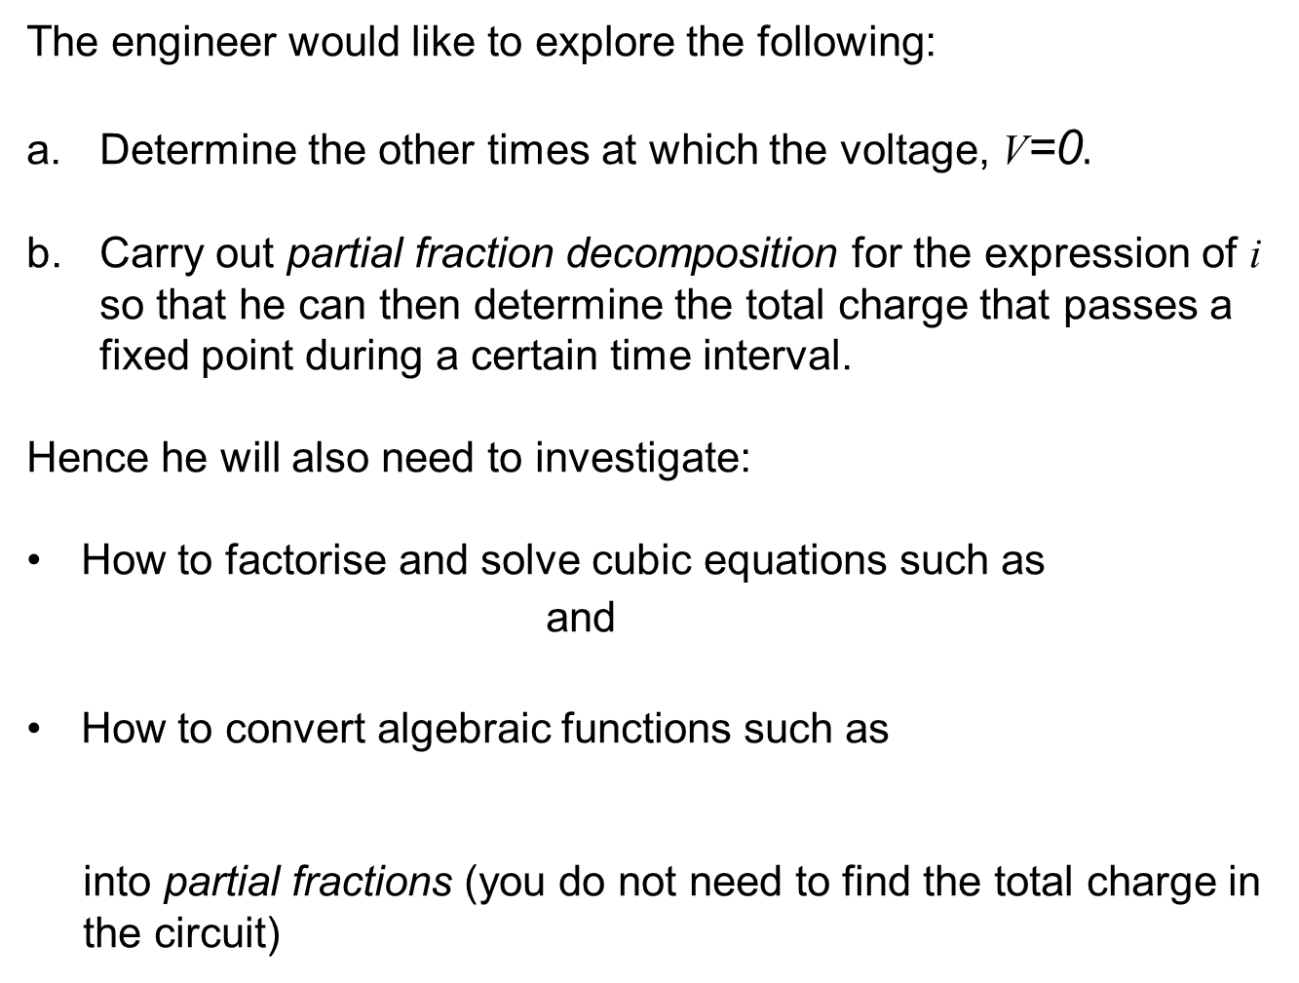
Scenario Tasks
The engineer would like to explore the following:
Determine the other times at which the voltage, V=0$.$
b. Carry out partial fraction decomposition for the expression of i so that he can then determine the total charge that passes a fixed point during a certain time interval.
Hence he will also need to investigate:
How to factorise and solve cubic equations such as
and
How to convert algebraic functions such as
into partial fractions (you do not need to find the total charge in the circuit)

Slide 4
Scenario Definition Template
What We Know:
What We Don’t Know:
What We Need to Find Out:

Slide 5
Lesson Overview
S/N | Concepts | Slide Number
1 | Polynomial Functions | 6-7
2 | Division of Polynomial Functions by Long Division | 8-11
3 | Remainder Theorem | 12-15
4 | Factor Theorem | 16-19
5 | Factorisation of Polynomial Functions | 21-22
6 | Introduction to Partial Fractions | 23
7 | Partial Fraction Decomposition | 24
8 | Proper and Improper Fractions | 25-27
9 | Partial Fraction Decomposition for Proper Fraction | 28-31
10 | Partial Fraction Decomposition for Improper Fraction (CL) | 32-35

Slide 6
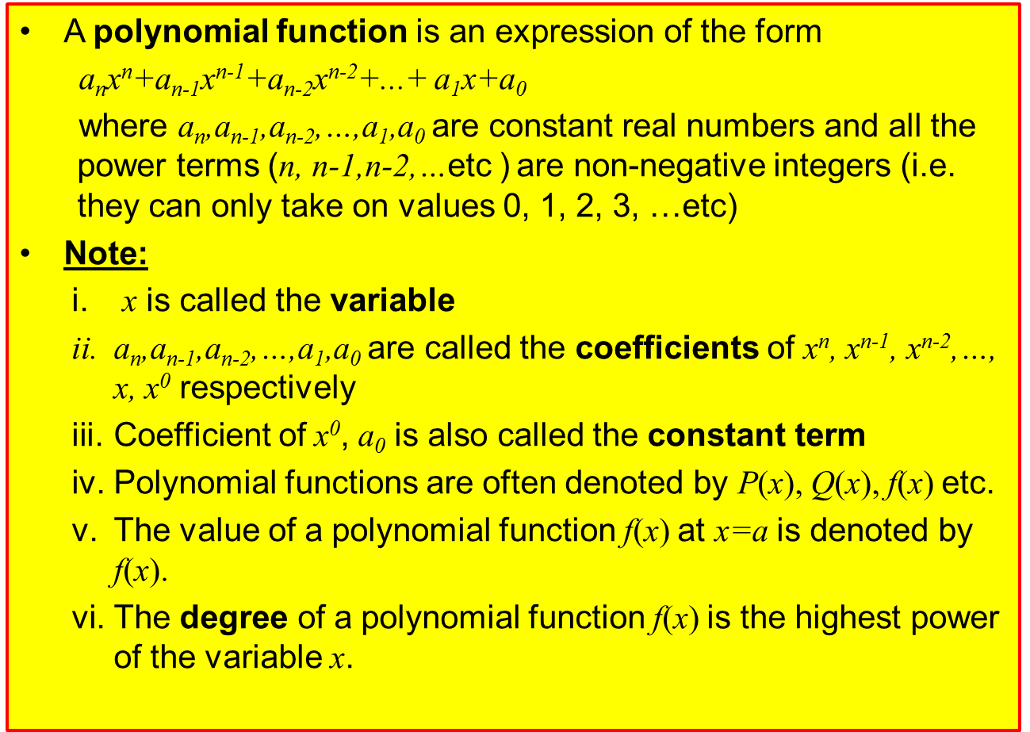
Polynomial Functions
A polynomial function is an expression of the form
a_{n}x^{n}+a_{n-1}x^{n-1}+a_{n-2}x^{n-2}+...+ a₁x+a₀
where a_{n},a_{n-1},a_{n-2},…,a₁,a₀ are constant real numbers and all the power terms (n, n-1,n-2,…etc ) are non-negative integers (i.e. they can only take on values 0, 1, 2, 3, …etc)
Note:
x is called the variable
a_{n},a_{n-1},a_{n-2},…,a₁,a₀ are called the coefficients of x^{n}, x^{n-1}, x^{n-2},…, x, x⁰ respectively
Coefficient of x⁰, a₀ is also called the constant term
Polynomial functions are often denoted by P(x), Q(x), f(x) etc.
The value of a polynomial function f(x) at x=a is denoted by f(x).
The degree of a polynomial function f(x) is the highest power of the variable x.

Slide 7
Polynomial Functions (Kahoot.IT)
[Example]
The following are polynomial functions:
Degree of P(x)=3
P(x) is called a cubic function
Degree of Q(x)=2
Q(x) is called a quadratic function
Degree of f(x)=1
f(x) is called a linear function
The following are not polynomial functions:
Reason: For x^{n}, n can only be 0,1,2,3,… but for , n=-1
Reason: For x^{n}, n can only be 0,1,2,3,… but for , n=0.5
Reason: For x^{n}, n can only be 0,1,2,3,… but for , n=1.5

Slide 8
Recall: Long Division
Recall how we have used the long division to find the quotient or remainder when one number is divided by another smaller number.
quotient
divisor
dividend
Note:
We stop the long division process once the remainder is less than the divisor
remainder
$∴$ dividend = divisor $×$ quotient $+$ remainder
e.g. 79 = 2 x 39 + 1

Slide 9

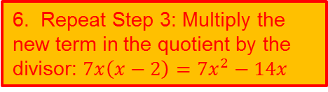
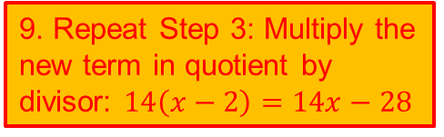
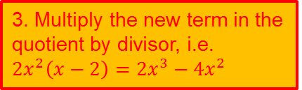

Division of Polynomial Functions by Long Division
A similar long division process also works for division of polynomial functions.
[Example]
6. Repeat Step 3: Multiply the new term in the quotient by the divisor: $7x\left(x−2\right)=7x^{2}−14x$
5. Repeat Step 2: Divide the 1st term of the new ‘dividend’ by 1st term of divisor: $\frac{7x^{2}}{x}=7x$
10. Repeat Step 4: Subtract and bring down the next appropriate term(s) from the dividend.
4. Subtract to get the remainder and bring down the next appropriate term(s) from the dividend.
9. Repeat Step 3: Multiply the new term in quotient by divisor: $14\left(x−2\right)=14x−28$
7. Repeat Step 4: Subtract and bring down the next appropriate term (s) from the dividend.
11. Stop when the degree of the remainder is less than degree of divisor.
1. Write down the divisor and dividend in descending powers of the variable, substituting each missing term by a zero coefficient or by leaving a blank space.
2. To get the 1st term of the quotient, divide the 1st term of dividend by 1st term of divisor
3. Multiply the new term in the quotient by divisor, i.e. $2x^{2}\left(x−2\right)=2x^{3}−4x^{2}$
8. Repeat Step 2: Divide the 1st term of the new “dividend” by 1st term of divisor: $\frac{14x}{x}=14$
Divide by .
[Solution]
quotient
divisor
dividend
remainder

Slide 10
Division of Polynomial Functions by Long Division
To summarise, the procedures for long division are:
1. Write down the divisor and dividend in descending powers of the variable, substituting each missing term either by a zero coefficient or blank space
2. Divide the 1st term of dividend by 1st term of divisor
3. Multiply the new term in the quotient by the divisor
4. Subtract and bring down the next appropriate term(s) from the dividend
5. Repeat Steps 2-4 until the degree of the remainder is less than the degree of the divisor.

Slide 11

Test Yourself: Division of Polynomial Functions by Long Division
Divide by , using long division. State the quotient and remainder.

Slide 12
Remainder Theorem
Instead of using long division which is tedious to find the remainder, we can use the Remainder Theorem.
The Remainder Theorem states that if a polynomial function f(x) is divided by a linear divisor x-a, the remainder is f(a).
More generally, if the linear divisor is of the form ax-b, the remainder is .
Try to prove this result by yourself in your free time!
[Proof]
Let Q(x) be the quotient and R be the remainder when the polynomial function f(x) is divided by x-a.
Then
(proven)
Recall (Slide 8):
Dividend = Divisor x Quotient + Remainder

Slide 13
Remainder Theorem
[Example]
Using the Remainder Theorem, find the remainder when is divided by
i.
ii.
iii.
[Solution]
Let
Remainder =
Remainder =
Remainder =

Slide 14
Remainder Theorem
[Example]
Find k if leaves a remainder of k when divided by .
[Solution]
Let
By the Remainder Theorem, remainder,

Slide 15
Think-Pair-Share: Remainder Theorem
In pairs, discuss and work out the following problem, and share your findings:
It is known that when is divided by
, the remainder is 10. Determine the value of b.

Slide 16
Factor Theorem
The Factor Theorem is a special case of the Remainder Theorem when the remainder = 0
The Factor Theorem states that if a polynomial function f(x) is divided by a linear divisor x-a, and if the remainder, f(a)=0, then x-a is a factor of f(x), i.e. f(x) = (x-a)Q(x) where Q(x) is quotient polynomial function.
Conversely, if x-a is a factor of f(x), then f(a)=0.
[Proof]
Let Q(x) be the quotient and R be the remainder when the polynomial function f(x) is divided by x-a.
Then
[R=f(a) by the Remainder Theorem]
[we say that x-a is a factor of f(x)]

Slide 17
Factor Theorem
[Example]
Determine whether x-2 is a factor of:
[Solution]
Let
Hence, x-2 is not a factor of f(x).
Let
Hence, x-2 is a factor of P(x).

Slide 18
Factor Theorem
[Example]
Given that x+2 is a factor of , where p is an unknown constant, determine the value of p.
[Solution]
Let
Since x+2 is a factor of f(x), by the Factor Theorem,

Slide 19
Test Yourself: Factor Theorem
Given that x-1 is a factor of , where k is an unknown constant, determine the value of k.

Slide 20
BRAIN BREAK
While physics and mathematics may tell us how the universe began, they are not much use in predicting human behavior because there are far too many equations to solve.
-- Stephen Hawking

Slide 21
Factorisation of Polynomial Functions
One way to factorise polynomial functions is to compare the coefficients, as shown by the example below.
[Example 8]
Given that , find a and b.
[Solution]
Expand the factorised form on the right hand side:
Recommend to put terms with the same power in the same column to avoid careless mistakes
Usually it is easier to compare coefficients of the terms with the highest and lowest powers first.
Comparing on both sides, coefficients of
and

Slide 22
Test Yourself: Factorisation of Polynomial Functions
Given that
Find a, b and c.

Slide 23
Introduction to Partial Fractions
To combine, say into a single fraction, we usually carry out the following algebraic manipulation:
The method of Partial Fraction Decomposition does the opposite:
It splits an algebraic fraction into a sum of two or more simpler fractions where the denominators of the fractions are the factors of the denominator of the original expression.
e.g. We want to write as .

Slide 24
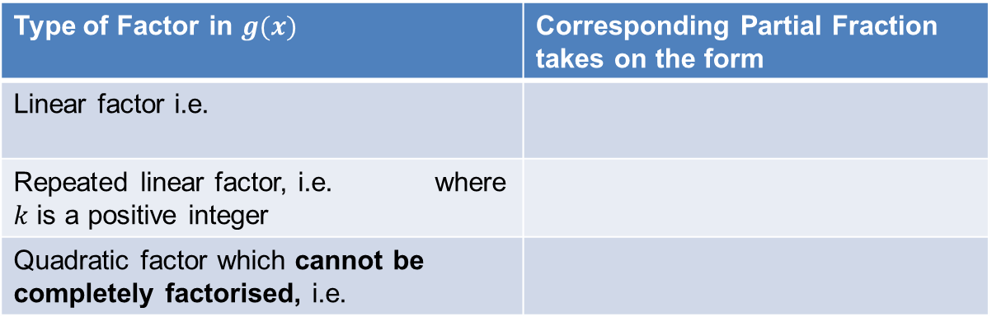
Partial Fraction Decomposition
Suppose we want to express an algebraic fraction of the form where f(x) and g(x) are polynomial functions in x, the method of Partial Fraction Decomposition is as follows:
1. Check that the degree of numerator f(x) is less than the degree of denominator g(x). If not, carry out long division.
2. Ensure that g(x) has been factorised completely.
3. For each factor in g(x), there corresponds a partial fraction:
4. Solve for the unknown constants in the partial fractions.
Type of Factor in $g(x)$ | Corresponding Partial Fraction takes on the form
Linear factor i.e.
Repeated linear factor, i.e. where $k$ is a positive integer
Quadratic factor which cannot be completely factorised, i.e.

Slide 25
Proper and Improper Fractions
If the degree of f(x) is less than the degree of g(x),
the fraction is a proper algebraic fraction.
e.g.
If the degree of numerator f(x) is greater than, or equal to, the degree of denominator g(x),
the fraction is an improper algebraic fraction.
e.g.

Slide 26

Test Yourself: Partial Fraction Decomposition
Fill in the blanks (in square brackets) for the following partial fractions using the crossword puzzle given:
i.
ii.
iii.
https://crosswordlabs.com/view/e114-slide-272

Slide 27
Test Yourself: Partial Fraction Decomposition

Slide 28
Partial Fraction Decomposition for Proper Fraction
[Example]
Express in partial fractions.
[Solution]
Apply the process of Partial Fraction Decomposition:
Check that degree of numerator is less than degree of denominator. If not, carry out long division.
Degree of numerator = 1
Degree of denominator = 2
Hence, we do not need to carry out long division.

Slide 29
Partial Fraction Decomposition for Proper Fractions
2. Ensure that the denominator has been factorised completely.
Denominator = has been factorised completely.
Express the algebraic fraction in its partial fractions.
Observe the denominator has two linear factors,
Hence let,

Slide 30
Partial Fraction Decomposition for Proper Fractions
Solve for the unknown constants in the partial fractions.
Multiply both sides by the denominator and simplify.
First, substitute x by any suitable value(s) to find as many unknown(s) as possible.
Let
Let

Slide 31
Test Yourself : Partial Fraction Decomposition
Express in partial fractions.

Slide 32
Partial Fraction Decomposition for Improper Fractions (CL)
[Example 11]
Express in partial fractions.
[Solution]
Apply the process of Partial Fraction Decomposition:
Check that degree of numerator is less than degree of denominator. If not, carry out long division.
Degree of numerator = 2
Degree of denominator = 2
Hence, we need to carry out long division.

Slide 33
Partial Fraction Decomposition for Improper Fractions (CL)
Long division:
Dividend = Divisor x Quotient + Remainder
Since is a proper algebraic fraction, we shall focus on applying Partial Fraction Decomposition technique to this fraction.

Slide 34
Partial Fraction Decomposition for Improper Fractions (CL)
2. Ensure that the denominator has been factorised completely.
Denominator = can be cross-factorised.
x
+1
+ x
x
+2
+2 x
x²
+2
+3 x

Slide 35
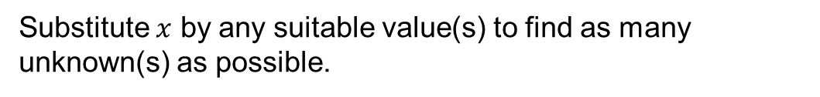
Partial Fraction Decomposition for Improper Fractions (CL)
Express the algebraic fraction in its partial fractions.
Let
Solve for the unknown constants in the partial fractions.
Multiply both sides by the denominator and simplify.
Substitute $x$ by any suitable value(s) to find as many unknown(s) as possible.
Let
Let

Slide 36
One-minute write
Instruction for lecturers: please copy the correct link and put it in the yellow box in the next slide for your IS class:
https://todaysmeet.com/LRE2-Day3
https://todaysmeet.com/LRE4-Day3
https://todaysmeet.com/LRW3-Day3
https://todaysmeet.com/LRW5-Day3
https://todaysmeet.com/LRE5-Day3
https://todaysmeet.com/LRE2-Day4
https://todaysmeet.com/LRE4-Day4
https://todaysmeet.com/LRW3-Day4
https://todaysmeet.com/LRW5-Day4
https://todaysmeet.com/LRE5-Day4
https://todaysmeet.com/LRE2-Day1
https://todaysmeet.com/LRE4-Day1
https://todaysmeet.com/LRW3-Day1
https://todaysmeet.com/LRW5-Day1
https://todaysmeet.com/LRE2-Day2
https://todaysmeet.com/LRE4-Day2
https://todaysmeet.com/LRW5-Day2
https://todaysmeet.com/LRW3-Day2

Slide 37
One-minute write
Instruction for lecturers: please copy the correct link and put it in the yellow box in the next slide for your IS class:
https://todaysmeet.com/LRE2-Day5
https://todaysmeet.com/LRE4-Day5
https://todaysmeet.com/LRW3-Day5
https://todaysmeet.com/LRW5-Day5

Slide 38
One-minute write
Please stop what you are doing and produce a written response to either of the following in only one minute:
Identify what is the key learning concepts from the seminar, or
Write down a question with respect to the concepts learnt so far.
Link:

Slide 39
Learning Objectives
Perform long division of polynomials
Apply remainder theorem to obtain remainders of polynomial divisions
Apply factor theorem to obtain factors of polynomials
Solve cubic equations
Differentiate between the proper and improper fractions consisting of polynomials
Perform partial fraction decomposition for proper fractions consisting of polynomials
Simplify improper fractions to proper fractions
Perform partial fraction decomposition for improper fractions consisting of polynomials (CL)

